Slide 1
Envision Illinois: Uniting Disability and Domestic Violence Services to Achieve Safety, Justice, and Healing

Slide 2
Acknowledgements
This work is supported by Grant No. 2017-FW-AX-K003 awarded by the Office on Violence Against Women, U.S. Department of Justice

Slide 3
Do you think domestic violence against people with disabilities and Deaf people is a problem?
Write your answer in the chat box:
Yes, a BIG problem
Not Really, RARELY occurs
No, NOT a problem
Not sure

Slide 4
Domestic Violence and People with Disabilities

Slide 5
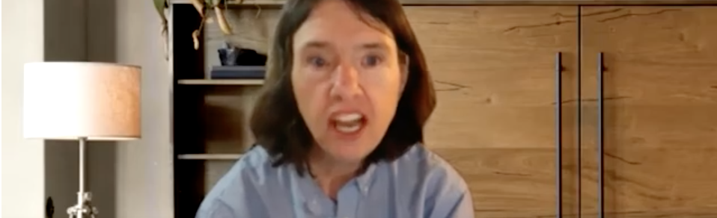
The Power of a Survivor’s Words
Kecia Weller, Peer Support Network
Kecia #MeToo story

Slide 6
Captioned video will be inserted here for presentation

Slide 7
What is Domestic Violence?

Slide 8
Prevalence - 1
92% of women with disabilities ranked violence and abuse as the top priority of topics that affected their lives.
The risk of being physically or sexually assaulted for adults with developmental disabilities is 4 to 10 times as high as it is for other adults.
Some studies indicate the level of sexual victimization to be 50% of all Deaf individuals as compared to 25% of hearing females and 10% of hearing males prior to adulthood.

Slide 9
Prevalence - 2
Bureau of Justice Statistics, 2021

Slide 10
Prevalence - 3
According to the Illinois Department on Aging Adult Protective Services’ 2021 Annual Report, there were 20,567 reports of abuse, neglect and financial exploitation of older adults (60 or older) and people with disabilities.

Slide 11
Power and Control
Power and Control Wheel
by Project Peer, 2011

Slide 12
Impact of Domestic Violence

Slide 13
Do survivors with disabilities and Deaf people access services designed for domestic violence victims?
Write your answer in the chat box:
No. They do NOT access domestic violence services.
Rarely. They only access domestic violence services RARELY.
Yes. They DO access domestic violence services.
Not sure.

Slide 14
Dicotomy
Higher Prevalence
Numbers Served

Slide 15
Barriers
Factors that contribute to victims with disabilities and Deaf victims not accessing services.
Victim does not know what happened to them is abuse.
People do not recognize caregiver abuse as domestic violence.
People often do not believe a victim when they report abuse.
Lack of accessibility and accommodations.

Slide 16
What is Trauma? - 1
“Trauma results from an event, series of events, or set of circumstances that is experienced by an individual as physically or emotionally harmful or threatening and that has lasting adverse effects on the individual’s functioning and physical, social, emotional, or social well-being.”
Substance Abuse and Mental Health Services Administration (SAMHSA), 2014

Slide 17
What is Trauma? - 2
An emotional response to a disturbing event and everyone does it differently.
Occurs when an event overwhelms the ability to cope.
Can occur with one large incident, an accumulation of smaller events or a combination of events.
Can have lasting effects on a person’s physical, emotional, social and spiritual well-being. The earlier in life that trauma is experienced, the more lasting the consequences.

Slide 18
Trauma and People with Disabilities
Trauma is widespread
Many people with disabilities have endured a lifetime of trauma. These may include
A lifetime of people trying to fix them
A lifetime of people calling them names
A lifetime of invalidation (being ignored, left out, never having a voice)
A lifetime of having choices taken away or being denied choices

Slide 19
Effects of Trauma
Lack a sense of safety
Feel disconnected from others (and maybe self)
Feel powerless
May experience grief over the many losses endured
May attempt to present a role of power in order to cover up personal vulnerability

Slide 20
Where are the Solutions?

Slide 21
A Trauma-Informed Approach is the Key
Three key elements:
realize the prevalence of trauma;
recognize how trauma affects all individuals within the program, organization or system, including its workforce; and
respond by putting this knowledge into practice.
*Response to the Individual
*How we set up Services
*How we set up the Organization
- SAMHSA

Slide 22
Survivors Need to Know
Will I be safe with you?
Can I believe in you tell me the truth and be honest?
Will you tell me what to do, or will you work with me?

Slide 23
How to Respond to Disclosures - 1
DO
Provide privacy
Listen without interrupting
Explain options
Support choices
Ensure safety
Don’t
Doubt
Blame
Judge
Punish

Slide 24
How to Respond to Disclosures - 2
Say:
I’m sorry this happened to you. Thank you for telling me. I believe you.
Support:
How can I help you? What do you need right now?

Slide 25
Mandatory Reporting
You may be a mandated reporter who is required to report.
There may be a mandated reporter who is required to report.
OIG – Office of Inspector General
APS – Adult Protective Services
IDPH – Illinois Department of Public Health
Criminal Justice System

Slide 26
Victim Services Response
Illinois Domestic Violence Programs
Advocates
Counseling
Shelter services
All services are free and confidential
Illinois Domestic Violence Hotline: 1-877-863-6338 https://www.ilcadv.org/

Slide 27
“People need to take time and listen, to be there. It is not something that just takes a few minutes but rather you need a long time to talk about it. People should listen and let you talk and not interrupt or stop you or ask a lot of questions.”
~ self-advocate victim of domestic violence

Slide 28
Healing is Possible
People are resilient and can recover even severe trauma with supports.
The survivor is the expert on how they feel.
It is hard to give up a behavior that kept them safe in the past.
Ask the person what you can do to make them feel more comfortable and how you can best work with them. Get to know the person.
To heal the person needs: safety, empowerment and connections with others

Slide 29
“No intervention that takes power away from the survivor can possibly foster his or her recovery.”
~ Judith Lewis Herman

Slide 30
Envision Illinois
Bringing Disability Services and Domestic Violence Programs Together
Notes:
.

Slide 31
Our goal is to . . .
Reduce Prevalence
Increase Served

Slide 32
About Envision Illinois
Envision Illinois is a statewide collaborative project addressing domestic violence against people with disabilities and Deaf people in order to transform the service system, so survivors can have equal access to healing, safety and justice.
Initially funded in 2013 by the Department of Justice, Office on Violence Against Women (OVW)
Focus Area: Domestic violence against people with disabilities and Deaf people
Focus Area: Statewide

Slide 33
Envision Illinois Partners
Illinois Department of Human Services (IDHS)
Illinois Department on Aging (IDoA)
Illinois Coalition Against Domestic Violence (ICADV)
Illinois Network of Centers for Independent Living (INCIL)
Illinois Self-Advocacy Alliance (“The Alliance”)
Blue Tower Solutions, Inc.
Illinois Family Violence Coordinating Councils (IFVCC) at the Illinois Criminal Justice Information Authority (ICJIA)

Slide 34
Resource Corner

Slide 35
Search by Type of Resource
Case studies and scenarios | Fact Sheets and Handouts
Presentation slides & training materials | Resource reviews and links
Role plays, activities & ice breakers | Sample forms and templates
Sample policies | Webinars
Mandatory Reporting Toolkit

Slide 36
Enter a Topic You Want to Learn About
Safety Planning
Link to the Resource Corner
https://www.ilcadv.org/envision-illinois/?type=14

Slide 37
Collaboration is the Path Forward to Safety, Justice and Healing
“No one organization offers all the services survivors with disabilities need in the aftermath of violence or possess all the expertise needed to provide those services in a way that is safe and accessible.”

Slide 38
Your Support Can Make a Difference

Slide 39
Contact Information
Jessena Williams, Project Director for Envision Illinois
Jessena.Williams@Illinois.gov
Krescene Beck
krescene@selfadvocacyalliance.org
Mary Hettel
mhettel2022@gmail.com
Questions? Comments?

