Slide 1
Plan Your Path - Puns & Beyond Workbook
Presented by:
Family Support Network
&
Ligas Family Advocate Program

Slide 2
This is your Planning Workbook.
We created this workbook to help you get started with your planning process. We hope that this guide becomes your GO TO document when you need to record something important or when you need to retrieve vital information.
You may:
Print it out
Keep it digital
Share it with your circle of support
Make it yours!

Slide 3
Important Basic Information
Name:
Nickname: (Optional)
DOB:
Medicaid ID#
Last 4 of Social:
Address:
Phone:
Email:

Slide 4
Photos
Add the most recent picture of your loved one.
Add a nice and fun picture of your loved one. Maybe even pictures of the things they like.

Slide 5
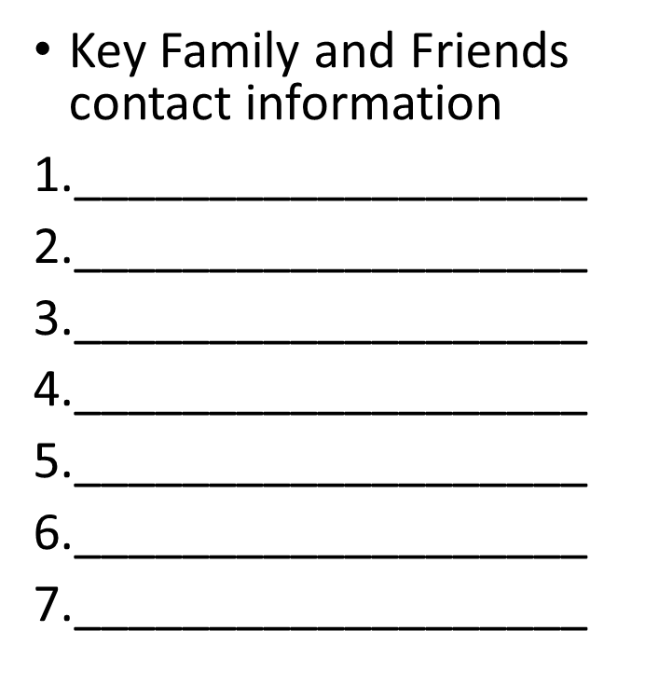
Contacts
Identify a group of people that you can count on when something happens.
Think of whom you would call first if you have an emergency
Make sure they are aware of this and keep in touch with them.
Inform other who is in this selected group.

Slide 6
Service Providers contact information:
Provider | Name | Email | Phone
Primary Doctor
Specialist
Physical Therapist
Occupational Therapist
Speech Pathologist
Counselor
Nurse

Slide 7
Contacts continued
Provider | Name | Email | Phone
School Transition Specialist
Social Worker
Ligas Family Advocate
ISC Agency
Attorneys / Legal Aid
Community Centers

Slide 8
Community Organizations
Look for agencies that provide services related to the conditions:
Examples: The Arc of Illinois for Intellectual/Developmental
My child has:
Autism- The Autism Program
Seizure Disorder- The Epilepsy Foundation
Down Syndrome- The Down Syndrome Association
Williams Syndrome – The Williams Syndrome Association

Slide 9
Kitchen Table Planning Use this space to brainstorm and gather a wealth of ideas, thoughts, and wishes. Be creative; use colors, markers, crayons, etc.
This Photo by Unknown Author is licensed under CC BY

Slide 11
Natural Supports: Family, Friends, Church Neighbors, etc.
You may rank them in order based on the commitment they show towards your expectations for the future.

Slide 12
Formalized Financial Supports
SSI/SSDI
SSA Social Security Administration
https://www.ssa.gov/benefits/disability/
Call 1-800-772-1213 (TTY 1-800-325-0778) from 8:00 a.m. to 7:00 p.m., Monday through Friday, to apply by phone.
Medicaid
https://abe.illinois.gov/abe/access/
You can call the DHS help Line at (800) 843-6154.
Medicare: Open Enrollment October 15- December 7th
https://www.medicare.gov
Phone: 800-633-4227
Housing Vouchers
Contact your Independent Service Coordinator for more info or visit the following website.
https://www.dhs.state.il.us/page.aspx?item=87600

Slide 13
Take notes when you interact with each entity.
Remember to keep a paper trail of everything you do. (Examples: email, fax, records keeping)
Write down the names and worker ID# if available.
Mark the date and time of each interaction.
Set reminders if you need to follow up with a task.

Slide 14
Developmental Disabilities Specific Supports
Take time to explore the DHS website to learn more about the services & programs
https://www.dhs.state.il.us/page.aspx?item=27894
Review page 6
The Pillars of Supports

Slide 16
Department of Rehabilitative Services
Vocational Rehabilitative (VR)
Personal Aide (PA)
https://www.dhs.state.il.us/page.aspx?item=29736

Slide 18
Make a list of likes and dislikes
For example: I dislike living alone.
Likes
Dislikes

Slide 19
Make a list of the things that make the ideal home!
This Photo by Unknown Author is licensed under CC BY-SA-NC

Slide 20
Make a list of the ideal JOB
Think about Supported Employment/ Vocational Training/ Workshops
Consider the things that in the skill set
Consider strengths and weaknesses

Slide 21
Non-Waiver Community Supports
Make a list of community organizations that can give you resources.
1. The Arc of Illinois https://www.thearcofil.org/
Build a network of professional supports
Visit our Ligas Family Advocate page to learn how we can help:
https://www.thearcofil.org/about-us/programs/ligas-family-advocate-program/
Make a contact list of key people that will help you in the process

Slide 22
Glossary
Hint: Highlight the acronyms that are most relevant to you.
DDD Acronyms: https://www.dhs.state.il.us/page.aspx?item=68922
Acronym or
Abbreviation Full Wording
ABLE Adult Basic Literacy Examination
ADA American Disabilities Act
BALC Bureau of Accreditation, Licensure and Certification
BCABA Board Certified Associate Behavior Analyst
BCBA Board Certified Behavior Analyst
CABA Certified Associate Behavior Analyst
CBA Certified Behavior Analyst
CE Continuing Education
CGH Child Group Home
CILA Community Integrated Living Arrangement
CANTS Child Abuse & Neglect Tracking System
CASAS Comprehensive Adult Student Assessment System

Slide 23
DD Developmental Disability
DDD Division of Developmental Disabilities
DHS Department of Human Services
DHSCRS Department of Human Services Community Reporting System
DMH Division of Mental Health
DoA Department on Aging
DSP Direct Support Person
DT Day Training
EIN Employer Identification Number
FEIN Federal Employer Identification Number
CBTA Competency-Based Training Assessment
CNA Certified Nursing Assistant
CRS Community Reporting System (or ROCS)
CRV Central Repository Vault
CSA Community Service Agreement
DASA Division of Alcohol and Substance Abuse
dba or DBA Doing Business As
DCFS Department of Children & Family Services
Mobius Mobius Management Reporting Systems, Inc.
RF Region Facilitator
NPI National Provider Identification
OJT On-the-Job Training
OT Occupational Therapy
PAS Pre-Admission Screening
POS Purchase of Service

Slide 24
PSW Personal Support Worker
PT Physical Therapy
QIDP Qualified Intellectual Disabilities Professional
RIN Recipient Identification Number
RN Registered Nurse
ROCS Reporting of Community Services
SAC Statewide Advisory Council
SEP Supported Employment Program
SLA Supported Living Arrangement
SODC State-Operated Developmental Center
SSA Social Security Administration
SSI Supplemental Security Income
SSN Social Security Number
TABE Test of Adult Basic Education
TIN Taxpayer Identification Number
IDHS Illinois Department of Human Services
FTP File Tape Protocol
GED Graduate Equivalent Diploma
HAN IDPH Health Alert Network (HAN) Web Portal
HBS Home-Based Services
HCBS Home and Community-Based Services
HCD Human Capital Development
HFS Department of Healthcare & Family Services
HIPAA Health Insurance Portability & Accountability Act
ICDD Illinois Council on Developmental Disabilities
ICFDD Intermediate Care Facility for Developmental Disabilities
ICFMR Intermediate Care Facility for Mental Retardation
IDPH Illinois Department of Public Health
IDFPR Illinois Department of Financial & Professional Regulation
IOC Illinois Office of the Comptroller
IRS Internal Revenue Service
ISC Independent Service Coordination
ISSA Individual Service and Support Advocacy
LL Limited Liability
LLC Limited Liability Corporation
LPN Licensed Practical Nurse
MIS Management Information Services

Slide 25
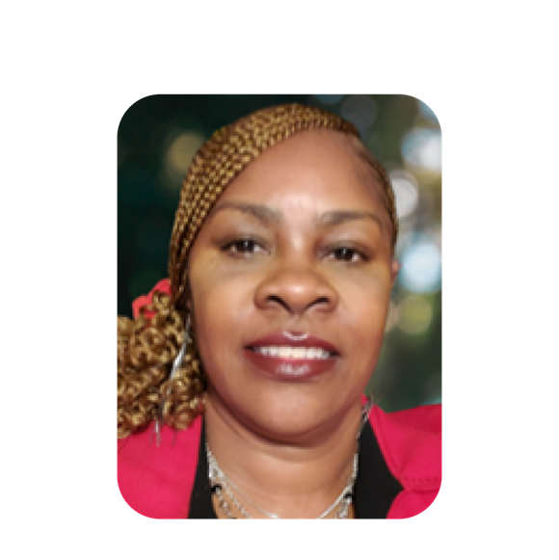
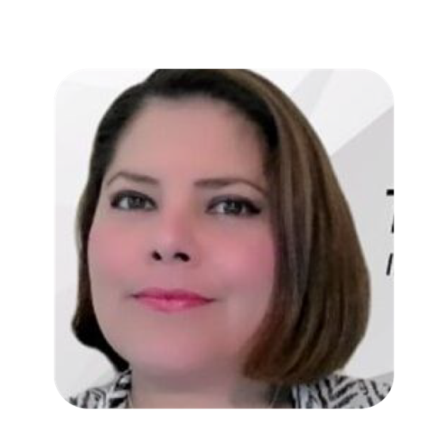
TEAM CHART
Shirley Pérez
LFA FSN Director
New Hire
Troy Market
FSN Specialist
Ruth Aguilar
Shakari Asbury
Annie Bruno
Senior LFA
Part Time LFA & FSN
LFA

Slide 26
Contact us
Shirley Perez, Director, LFA/FSN
Shirley@thearcofil.org; 815-464-1832 x1032
Ruth Aguilar, Senior LFA Ruth@thearcofil.org;
815-464-1832 x1033
Shakari Asbury
FSN/LFA Administrative
815-277-6732
Shakari@thearcofil.org
Annie Bruno, LFA Central and Southern Region Annie@thearcofil.org 815-464-1832 x1022

